Slide 1
ATAI
Advanced Techniqueof Artificial Intelligence
ATAI
ChongqingUniversity _{AdvancedTechniqueof}
of Technology Artificial Intelligence
Chongqing University of
Technology
Chongqing University ^{ATAI}
_{of Technology} Advanced Techniqueof
Artificial Intelligence
Chongqing University of Technology
Chongqing University of Technology
TelME: Teacher-leading Multimodal Fusion Network for Emotion Recognition in Conversation
TelME: Teacher-leading Multimodal Fusion Network for Emotion Recognition in Conversation
Code:https://www.github. com/yuntaeyang/TelME
—— NAACL 2024
Reported by Tingting Zhang
1

Slide 2
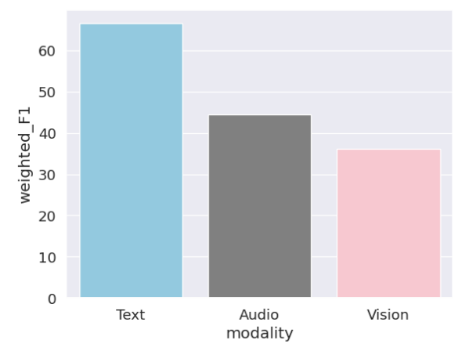
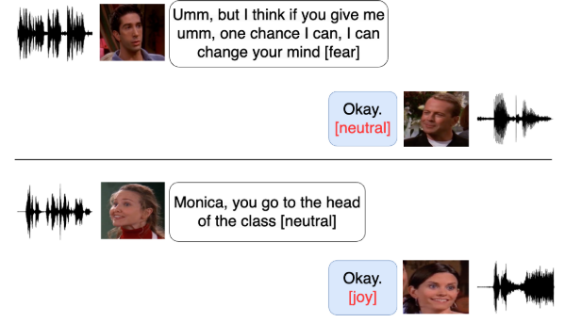
ATAI
AdvancedTechniqueof
Artificial Intelligence
ATAI
ChongqingUniversity _{AdvancedTechniqueof}
of Technology Artificial Intelligence
ChongqingUniversity of Technology
Motivation
1. ERC research has predominantly concentrated on context modeling from text, neglecting rich representations from audio and visual modalities.
Non-verbal cues such as facial expressions and tone of voice, which are not covered by text-based methods, provide important information that needs to be explored in the field of ERC.
2. While multimodal approaches integrate characteristics from all three modes, they often overlook the varying degrees of influence each mode has on emotion recognition.

Slide 3
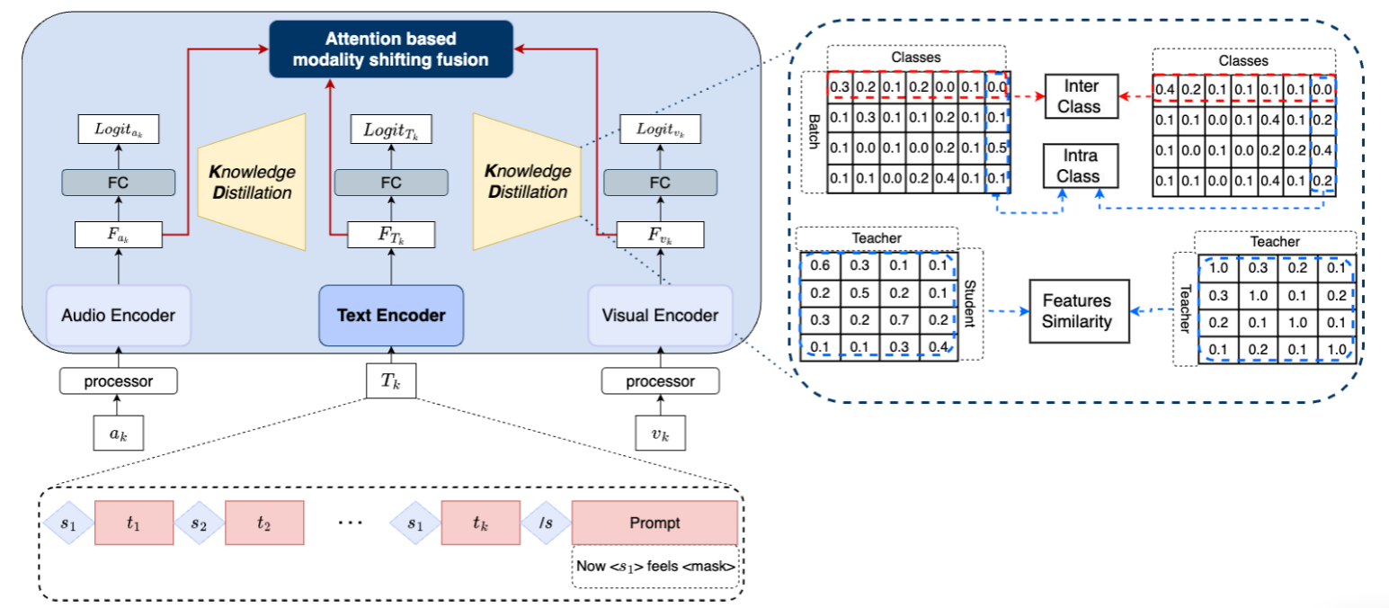
ChongqingUniversity of Technology
ATAI
AdvancedTechniqueof
Artificial Intelligence
ATAI
ChongqingUniversity _{AdvancedTechniqueof}
of Technology Artificial Intelligence
Overview

Slide 4
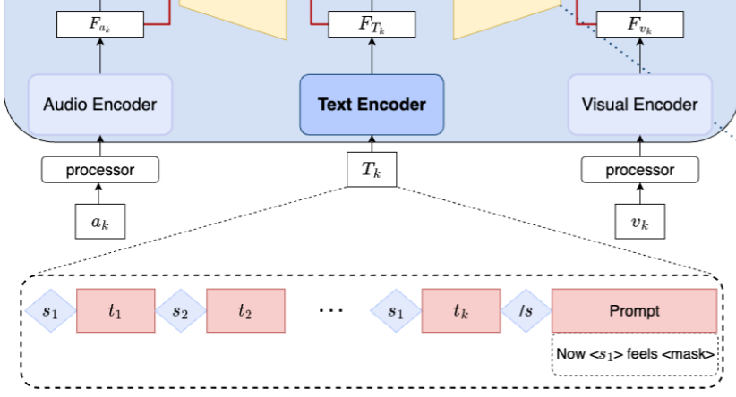
ChongqingUniversity of Technology
ATAI
AdvancedTechniqueof
Artificial Intelligence
ATAI
ChongqingUniversity _{AdvancedTechniqueof}
of Technology Artificial Intelligence
Method
1. Feature Extraction

Slide 5
ChongqingUniversity of Technology
ATAI
AdvancedTechniqueof
Artificial Intelligence
ATAI
ChongqingUniversity _{AdvancedTechniqueof}
of Technology Artificial Intelligence
Method
2. Knowledge Distillation

Slide 6
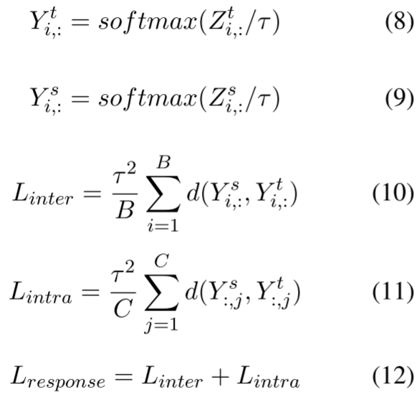
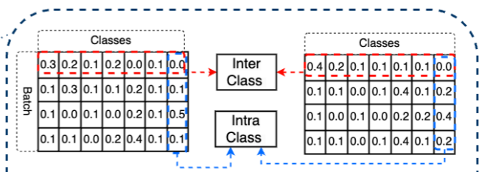
ChongqingUniversity of Technology
ATAI
AdvancedTechniqueof
Artificial Intelligence
ATAI
ChongqingUniversity _{AdvancedTechniqueof}
of Technology Artificial Intelligence
Method
2. Knowledge Distillation

Slide 7
ChongqingUniversity of Technology
ATAI
AdvancedTechniqueof
Artificial Intelligence
ATAI
ChongqingUniversity _{AdvancedTechniqueof}
of Technology Artificial Intelligence
Method
2. Knowledge Distillation

Slide 8
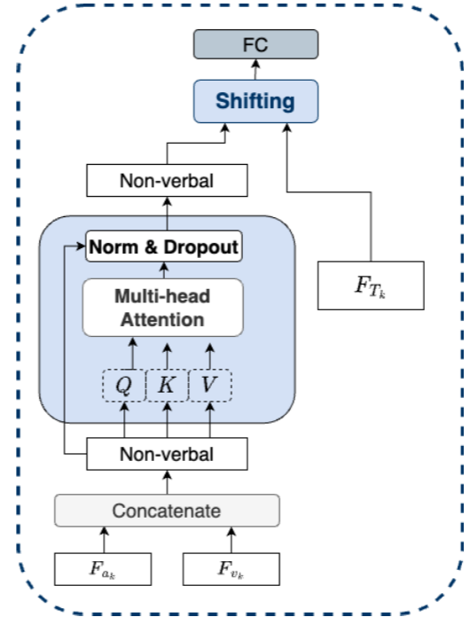
ChongqingUniversity of Technology
ATAI
AdvancedTechniqueof
Artificial Intelligence
ATAI
ChongqingUniversity _{AdvancedTechniqueof}
of Technology Artificial Intelligence
Method
3. Attention-based modality Shifting Fusion

Slide 9
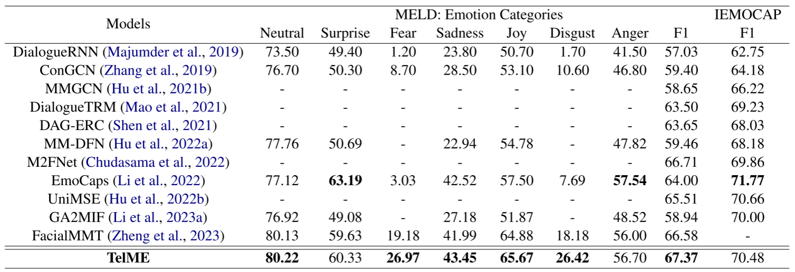
ATAI
AdvancedTechniqueof
Artificial Intelligence
ATAI
ChongqingUniversity _{AdvancedTechniqueof}
of Technology Artificial Intelligence
ChongqingUniversity of Technology
Experiments

Slide 10
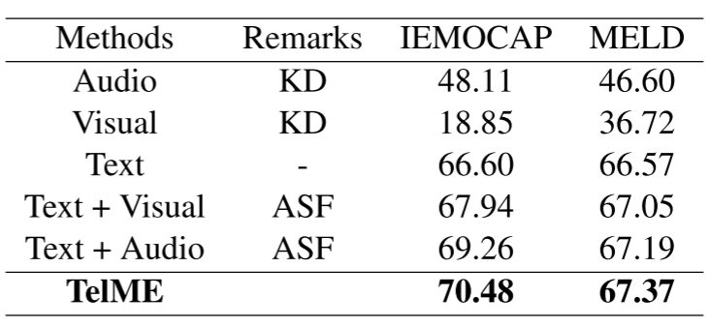
ATAI
AdvancedTechniqueof
Artificial Intelligence
ATAI
ChongqingUniversity _{AdvancedTechniqueof}
of Technology Artificial Intelligence
ChongqingUniversity of Technology
Experiments

Slide 11
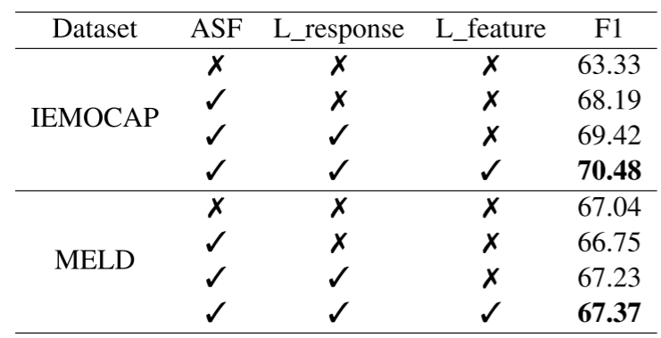
ATAI
AdvancedTechniqueof
Artificial Intelligence
ATAI
ChongqingUniversity _{AdvancedTechniqueof}
of Technology Artificial Intelligence
ChongqingUniversity of Technology
Experiments

Slide 12
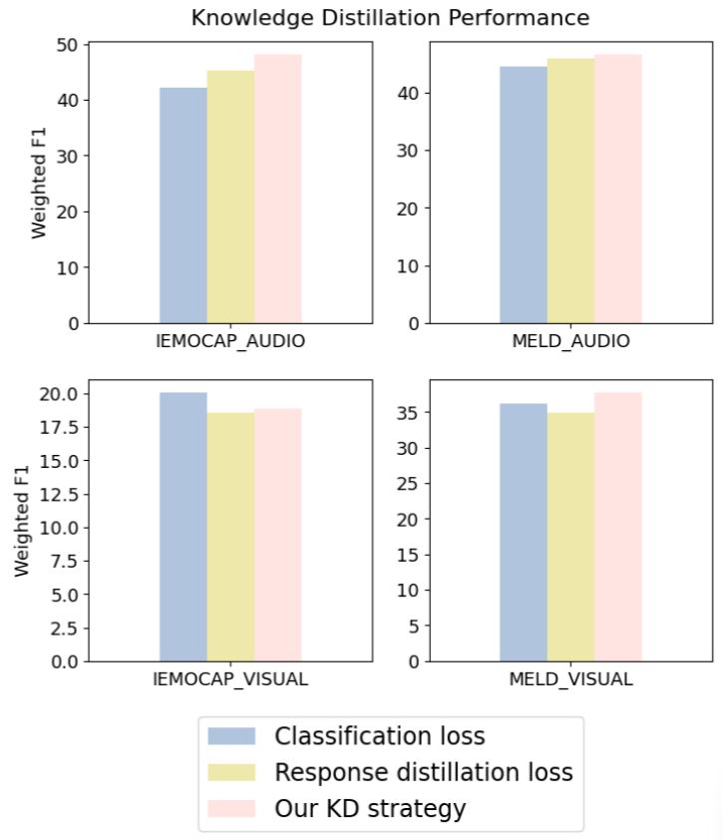
ATAI
AdvancedTechniqueof
Artificial Intelligence
ATAI
ChongqingUniversity _{AdvancedTechniqueof}
of Technology Artificial Intelligence
ChongqingUniversity of Technology
Experiments

Slide 13
ChongqingUniversity of Technology
ATAI
AdvancedTechniqueof
Artificial Intelligence
ATAI
ChongqingUniversity _{AdvancedTechniqueof}
of Technology Artificial Intelligence
Thanks!

